Slide 1
SNHU Travel
Agile Development

Slide 2
Agile Team Roles
User Specific Roles
Product Owner
The product owner provides the interface with key stakeholders outside the team. They are the subject matter expert on the product being developed as well as being the voice of management, voice of the customer, and key stakeholder that establishes overall priority of the back-log tasks.
Scrum Master
The Scrum Master is the person who is responsible for coordinating the team members, conducting scrum events, working with the product owner for backlog grooming, and general road-block clearing agent for the development team. This person is the main information gatherer and distributor through the form of information radiators such as meeting minutes and burn-charts.
Development Team
The development team represents the entirety of the technical and support staff assigned to the project who actively generate the product. Typically these individuals are engineers of one form or another, typically software, but not exclusively, depending on the scope of the product being worked on.

Slide 3
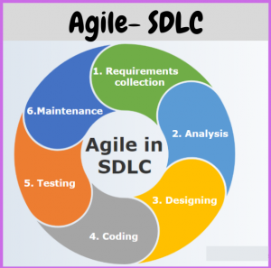
Agile in Software Development Life Cycle
1. Requirements Collection
With Agile in step 1, the product owner gathers user stories and other inputs needed to understand the overall goal of the project and business needs. These are prioritized initially and may be adjusted later as needs change
2. Analysis
Prior to the start of a sprint, the scrum master and development team break down the work that will be worked on during the upcoming sprint, typically ~2 weeks in duration. These work tasks are expected to complete during the sprint cycle and include done criteria to clearly define what DONE means for the given task. The work is chosen based on the priority as set by the Product Owner.
Ssla-Co-Uk, 2018

Slide 4
Agile in Software Development Life Cycle
3. Designing
During the design phase (in sprint cycle), the design team can present a very quick sketch of the expected design and seek confirmation if required (optional step if needed). This can include defining tests or optional variations of the output. This phase operates concurrently with steps 4 and 5 in the agile workflow.
4. Coding
During the coding phase, each development team member actively works on their individual contributions to the sprint goals. Testers develop test cases, and coders develop code that will be tested. This phase operates concurrently with steps 3 and 5 in the agile workflow.

Slide 5
Agile in Software Development Life Cycle
5. Testing
Testing phase in the Agile methodology occurs concurrent with steps 3 and 4, as soon as code is available, the code is tested at every iteration (bug fix/feature add/etc.) to ensure the code is accurate to the needs, is bug free, and creates no regressions. The testers help to determine when a code block is done and has met the intended minimum outputs and has produced WORKING code.
6. Maintenance
In the Agile workflow, Maintenance is entered during the closure of each sprint when a new WORKING code update is pushed out. The team will monitor for issues during the following sprint, and will schedule any changes required for maintenance alongside new development tasks during the sprint planning meetings.

Slide 6
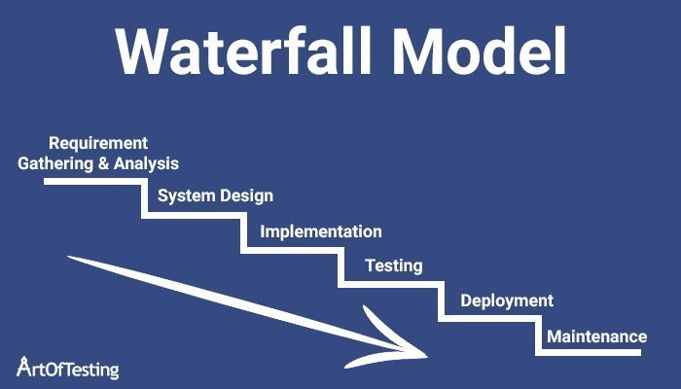
Waterfall Model
When using the waterfall method, the SDLC will flow from steps 1-6 sequentially.
During phase 1,Requirements, all requirements are collected and formalized into a given project charter and formal requirements are generated.
Only once this is completed, can phase 2, analysis, begin. The requirements from phase 1 are deconstructed and broken down into appropriate subgroups to be worked on and developed as applicable. Once the analysis has completed, then the process can proceed to phase 3.
Rana, 2019

Slide 7
Waterfall Model
Phase 3, Designing, is the state where the overall architecture, basic user interfaces, and similar very high level decisions are firmed up that will drive the overall implementation approach to the given development effort.
Phase 4, Coding, is when all respective developers generate functional code that will form collectively into the final product output. This code is developed against the design phase outputs and the overall requirements to ensure complete implementations.
Ssla-Co-Uk, 2018

Slide 8
Waterfall Model
Phase 5, Testing, triggers when the coding effort has completed. The tester takes the produced output from step 4, and runs automated and manual testing events against the product to ensure it meets all the original requirements from Phase 1.
Once the testing has completed and passed, the code is released to the customer and phase 6 begins.
Phase 6, the code is live with the customer, who reports bugs and other changes, where the development team can address the changes as required. This is the final phase during a typical release cycle unless additional releases are planned where the cycle will repeat.
Ssla-Co-Uk, 2018

Slide 9
Waterfall vs Agile
Agile
Pros
Scope of effort easily changed during each sprint. Change is embraced
Fast feedback loops, bugs found faster
Delivers incremental WORKING code each sprint.
Can start very quickly
Good for high uncertainty projects
Cons
Difficult to see the big picture
Easily susceptible to scope creep
Waterfall
Pros
Easier view of the big picture
Easier to budget
More resistant to scope creep
Good for simple unchanging projects
Good for projects with low uncertainty
Cons
Changes are difficult, requires replanning
Testing can be late causing more costly changes, delays
Slow to start, requires full analysis before work can start.

Slide 10
Agile For SNHU Travel
Through the trial of AGILE SCRUM for the SNHU travel, it was clear that the AGILE approach was a success.
There were mid effort changes that required the development team to pivot approaches. First from a vertical slider presentation style to a slide-show style format. Second was a change in the type of content that was targeted to launch with.
With the traditional waterfall approach, either of these changes would have required the project to pause while the impacts were evaluated, and the appropriate requirements changed, etc. This would have guaranteed the project to have failed to deliver the right content at the right time.
The AGILE philosophy of ‘embrace change’ was perfect for this project as the level of uncertainty entering into the project was high, which is a poor fit for the waterfall approach.

Slide 11

Sheetal, 2021

Slide 12
Citations
ssla-co-uk. (2018, June 18). Ssla-Co-Uk. https://www.ssla.co.uk/sdlc/
Sheetal. (2021, September 23). 20 Hilarious Memes For Those Who Have Worked in the Agile Framework. Medium; JavaScript in Plain English. https://javascript.plainenglish.io/20-hilarious-memes-for-those-who-have-worked-in-the-agile-framework-e6c17b4d8260
Charles G. Cobb. (2015). The Project Manager’s Guide to Mastering Agile : Principles and Practices for an Adaptive Approach. Wiley.:
Rana, K. (2019, December 7). Waterfall Model in Software Engineering - Features, Advantages & Disadvantages. ArtOfTesting. https://artoftesting.com/waterfall-model

